Slide 1

CNN-Based Defect Detection in Manufacturing Images
Project Proposal
Group Members: Evan Musick & Breydan Walker
Course: CSC 537 - Deep Learning
Instructor: Mukulika Ghosh

Slide 2

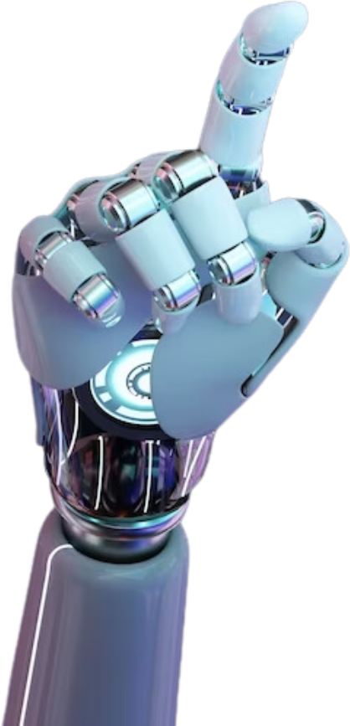
Problem Statement
02
What Problem Are We Addressing?
Automated defect detection is essential for quality control in manufacturing.
Traditional inspection methods are manual, time-consuming, and prone to human error.
CNNs can efficiently classify and detect manufacturing defects in images.
Why is This a Problem?
Manual inspection lacks scalability and consistency.
Undetected defects can lead to increased costs, safety issues, and reduced customer satisfaction.
Why Will a DL/ML Approach Help?
CNNs excel in image classification and object detection.
Reduce dependency on human intervention and provide faster, more accurate results.

Slide 3
Dataset
03
Which Dataset Will Be Used?
NEU Surface Defect Dataset
Contains 1,800 grayscale images of six common surface defects in hot-rolled steel: crazing, inclusion, patches, pitted surface, rolled-in scale, and scratches.
Each defect class contains 300 labeled images, making it a well-balanced dataset for training.
Images are of size 200 × 200 pixels and were collected under real-world industrial settings.
https://www.kaggle.com/datasets/kaustubhdikshit/neu-surface-defect-database
Size and Content
1,800 labeled images categorized into six defect types.
Designed for surface defect classification and segmentation tasks.
Potential preprocessing steps: grayscale normalization, histogram equalization, and augmentation techniques (rotation, flipping, contrast adjustment).

Slide 4
Approach
04
Methodology
Preprocessing
Convert images to a standardized format.
Apply data augmentation (rotation, contrast adjustment, flipping) to enhance generalization.
Model Architecture
CNN-Based Approach:
Utilize architectures such as ResNet, VGG, EfficientNet.
Implement Transfer Learning with a pre-trained model on ImageNet.
Fine-tune the final layers for defect classification.
Alternative Approach:
Implement U-Net for defect segmentation to localize defects in images.
Training Strategy
Train using stochastic gradient descent (SGD) or Adam optimizer.
Loss function: Cross-Entropy for classification, IoU Loss for segmentation.
Evaluate using accuracy, precision, recall, F1-score, and confusion matrix.
Comparison with Traditional ML Techniques
Train an SVM or Random Forest on extracted features.
Compare accuracy and inference speed with CNN-based models.

Slide 5
To-Do Tasks
05
Topics to Research Further
Review existing research on steel surface defect detection using CNNs.
Compare different CNN architectures for this specific task.
Study transfer learning and its effectiveness on small datasets.
Implementation Setup
Platform: Google Colab, PyTorch/TensorFlow.
Libraries: OpenCV, NumPy, Matplotlib, TensorFlow/Keras, PyTorch.
Hardware Requirements: GPU acceleration for training efficiency.
Anticipated Challenges
Limited dataset size: Need for augmentation to improve generalization.
Computational cost: Training deep CNN models requires significant resources.
Class imbalance: Minor defects may be harder to classify correctly.
Hyperparameter tuning: Optimize learning rate, dropout, and regularization

Slide 6

06
Conclusion
This project aims to develop an automated defect detection system using CNNs for steel surface defects.
The approach will improve accuracy, speed, and consistency compared to traditional methods.
Implementation and evaluation will help assess CNN effectiveness in real-world manufacturing environments.

